Slide 1
Head Size Vs Brain WeightMachine Learning(Linear Regression)
OMKARAIAH
PGDA25

Slide 2
The data contains the following columns:
GENDER
AGE RANGE
HEAD SIZE
BRAIN WEIGHT

Slide 3
DF.HEAD()
Gender | Age Range | Head Size(cm^3) | BrainWeight
0 | 1 | 1 | 4512 | 1530
1 | 1 | 1 | 3738 | 1297
2 | 1 | 1 | 4261 | 1335
3 | 1 | 1 | 3777 | 1282
4 | 1 | 1 | 4177 | 1590

Slide 4
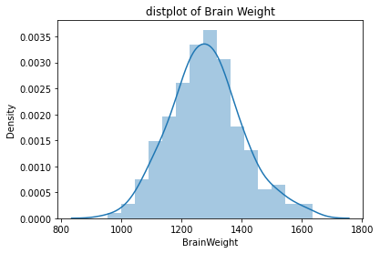
TARGET VARIABLE : BRAIN WEIGHT
sns.distplot(df.BrainWeight)
plt.title('distplot of Brain Weight')

Slide 5
df.BrainWeight.describe()
count 237.000000
mean 1282.873418
std 120.340446
min 955.000000
25% 1207.000000
50% 1280.000000
75% 1350.000000
max 1635.000000
Name: BrainWeight, dtype: float64

Slide 6
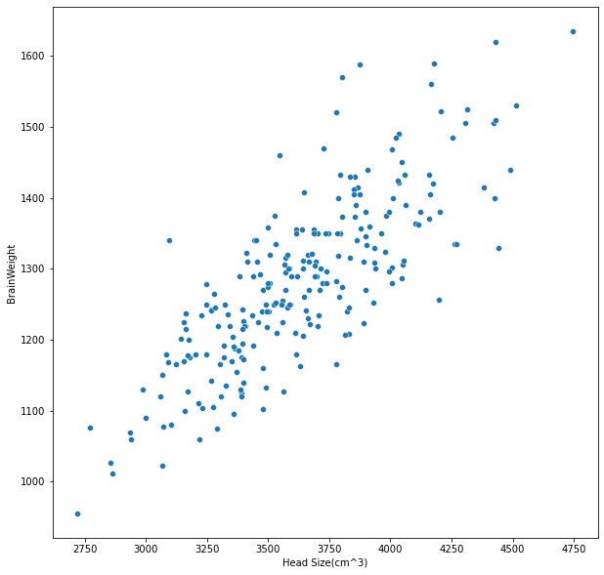
Scatterplot of y='BrainWeight',x='Head Size’

Slide 7
R-SQUARE
slope = 0.26189100385866426
intercept = 331.2228421304119
R-squared : 0.6715300229289938

Slide 8
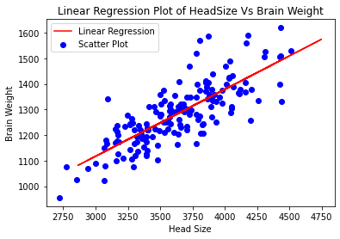
LINEAR REGRESSION PLOT OF HEAD SIZE VS BRAIN WEIGHT

Slide 9
THANK
YOU

